Slide 1

FTDS Aug 2022- Deep Learning Project
Anmol Thadani
Jonas chan

Slide 2
Agenda
Aim of this project
Business Value
Data Collection
Data Preprocessing
Exploratory Data Analysis
Deep Learning Algorithms + Hyperparameter Tuning
Sentiment Analysis
Insight Analysis
Challenges, Limitations, and Next Steps
Conclusion

Slide 3
Aim of this project
To help in discovering the future value of S&P500, NASDAQ, and DowJones
End goal in prediction, or for any businesses, is to gain profits

Slide 4

Business Value
When a price steadily increase, it is an indicator that a company is steering its operations towards profitability
This attracts potential investors since a higher share price increases customer’s interest as they would naturally expect a higher return
This will allow companies to attract high quality employees with stock prices going up.

Slide 5
Data Collection
Extracted from MarketWatch
Using 5year data from 26th December 2017 all the way to 23th December 2022

Slide 6
Data Preprocessing
Removed the ‘Open,High, and Low’ columns as it would not be useful in our analysis
sp500 = sp500.drop(sp500.columns[[1, 2, 3]], axis = 1)
sp500.rename(columns = {" Close":'S&P_close'}, inplace = True)
Renamed the Close column corresponding to S&P500, NASDAQ, and DowJones

Slide 7
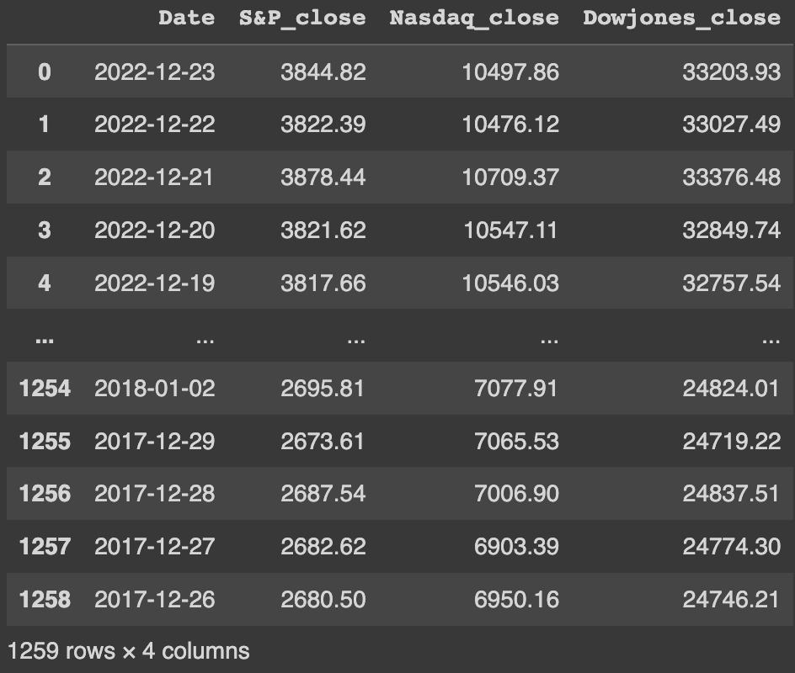
Data Preprocessing ‘cont
Merged all the three cleaned csv files into one data frame using: df1 = pd.concat([sp500, nasdaq], axis=1)
However, there were some null values after which we removed it using dropna()

Slide 8
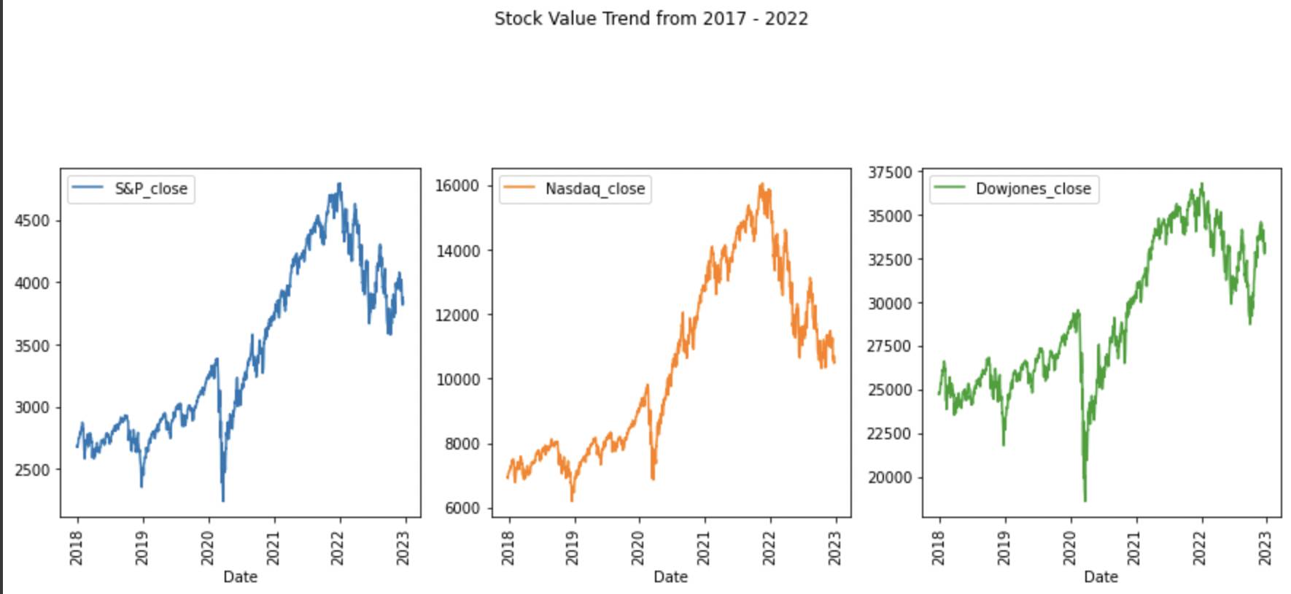
Exploratory Data Analysis
Created a variable called ’Column List’ with the closing price of S&P500, NASDAQ, DowJones

Slide 9
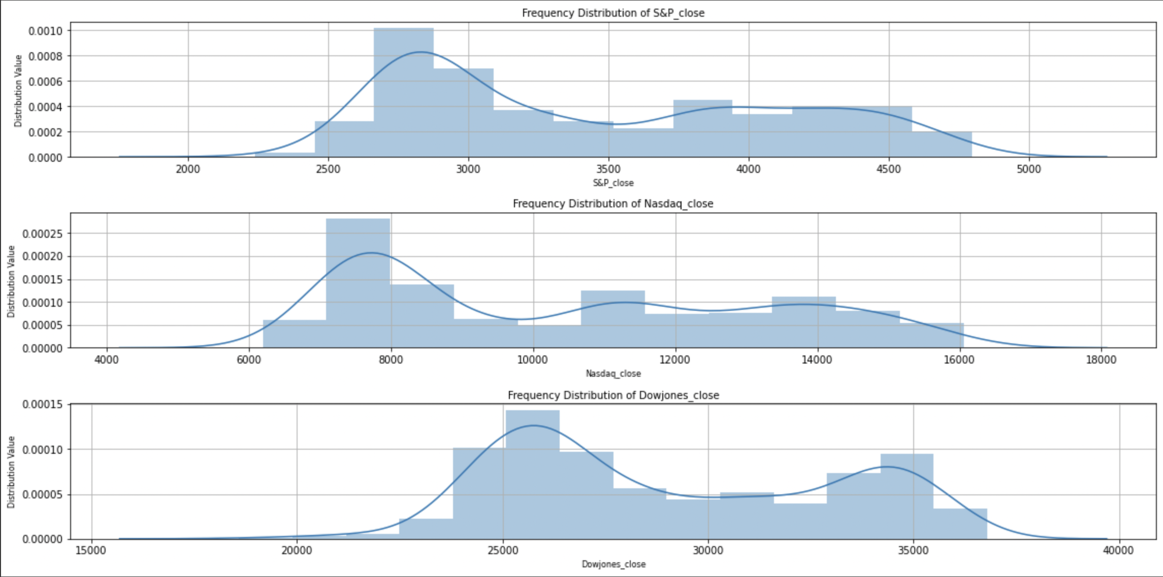
Exploratory Data Analysis (skewness)
Used a distribution plot

Slide 10
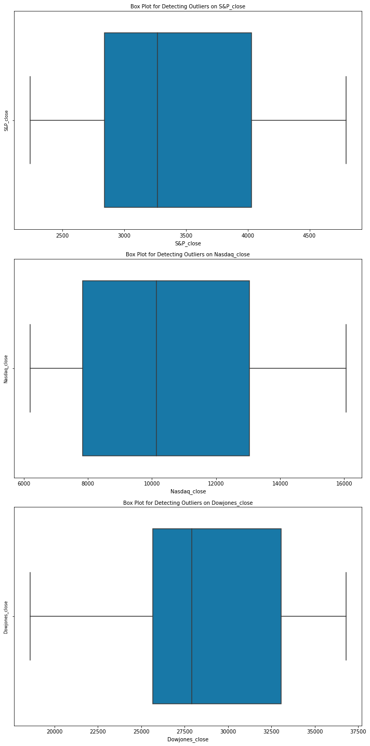
Exploratory Data Analysis (outliers)
Used a boxplot
Calculated the IQR, values are as follows:
S&P_close=1188.460
Nasdaq_close=5202.965
Dowjones_close=7390.565

Slide 11
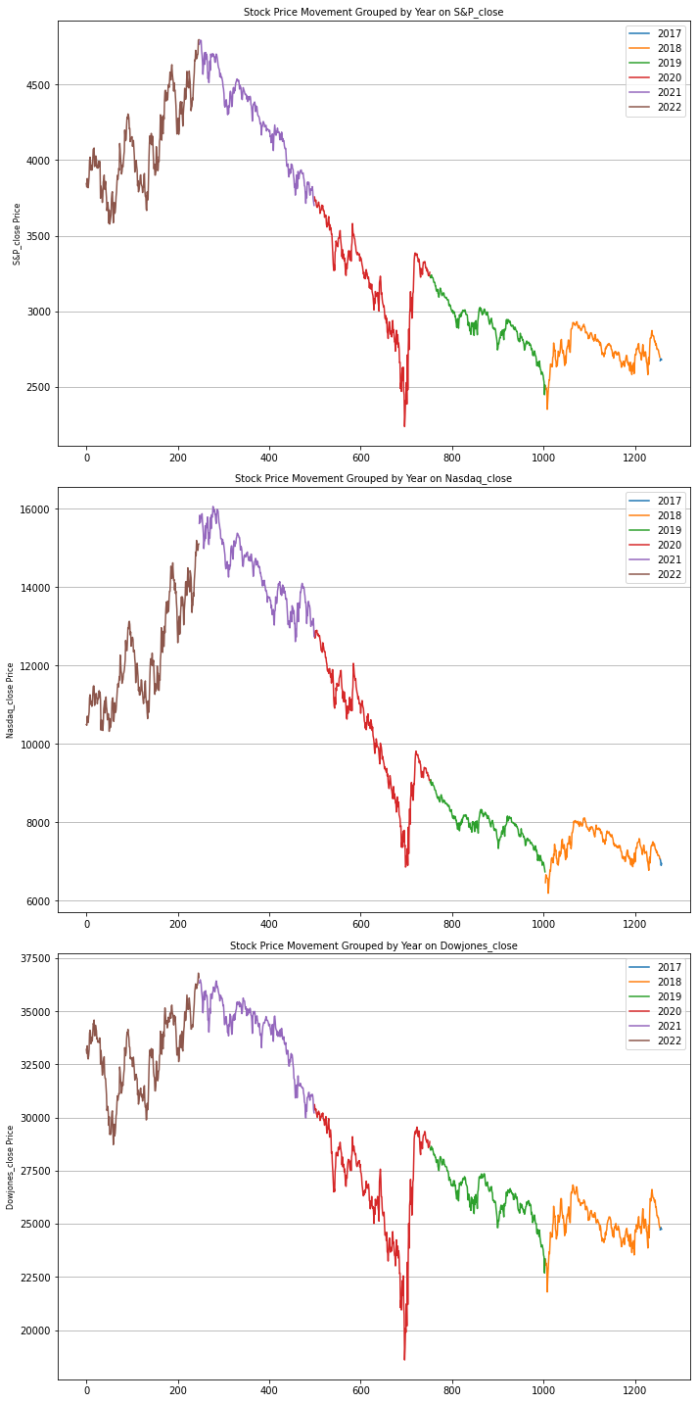
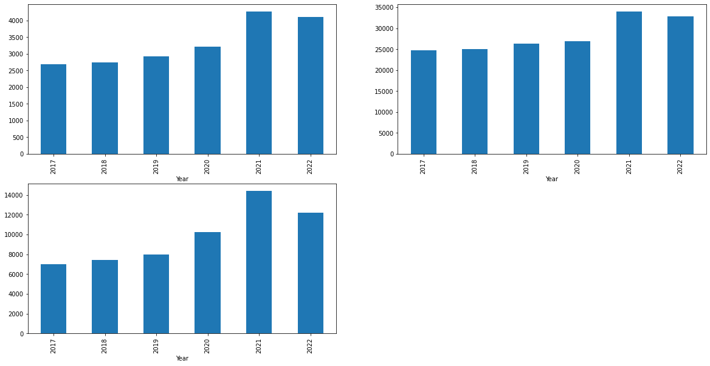
Exploratory Data Analysis (time-series)
According to the year

Slide 12
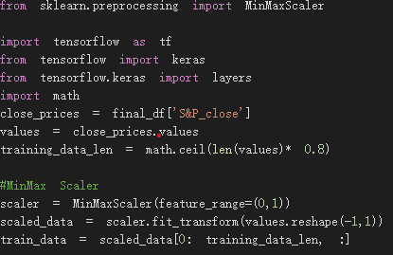

LSTM Model - Preparation of data
Deep learning API: Tensorflow Keras
Close price of S&P 500 (“S&P_close”)
Normalisation of data (MinMax Scaler)
Spliting dataset for training and testing

Slide 13

LSTM Model - Preparation of data
Preparation of training data (90 days of data to predict stock price of the 91st day)
Turn x_train and y_train data into NumPy array
Reshape x_train data

Slide 14
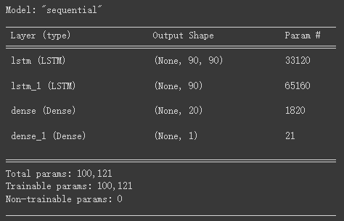
LSTM Model - Building of model
LSTM model structure
Two LSTM layers (90 neurons each)
One dense layer (20 neurons)

Slide 15
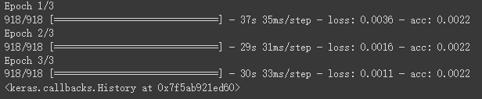
LSTM Model - Training the model
Compile model
Batch size: 1
Epochs: 3

Slide 16
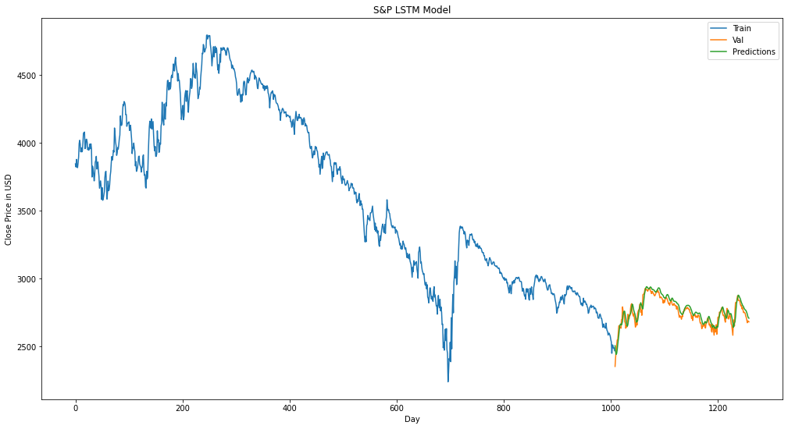
LSTM Model - Visualisation training, validating and predicting prices
Train
Val
Predictions

Slide 17
Sentiment Analysis
Used GoogleNews, newspaper3k, and nltk as the libraries
Gathered relevant news and organized it according to its sentiment (positive, negative, and neutral)
Created a dataframe for S&P 500, NASDAQ, and DowJones

Slide 18

THE END

